Slide 1
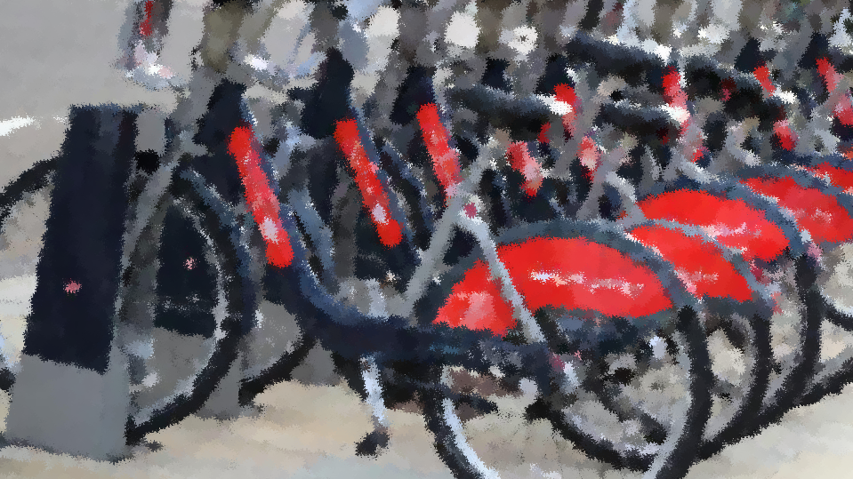
TFL Cycling Dataset Analysis
By Sandnyit Pathare

Slide 2
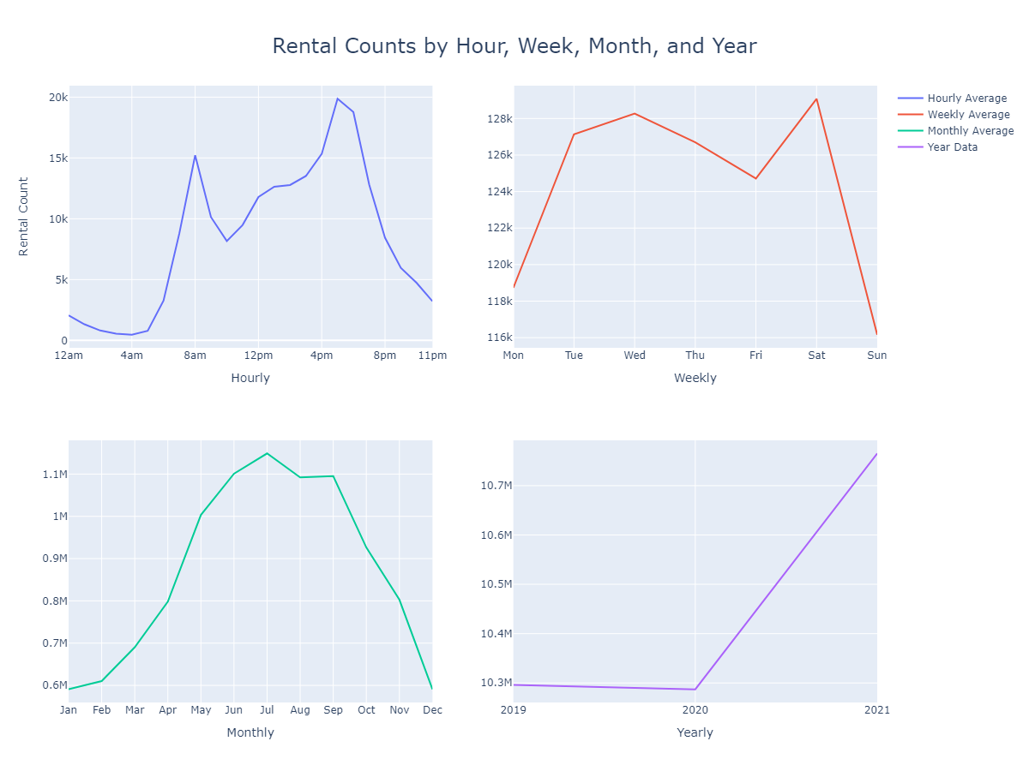
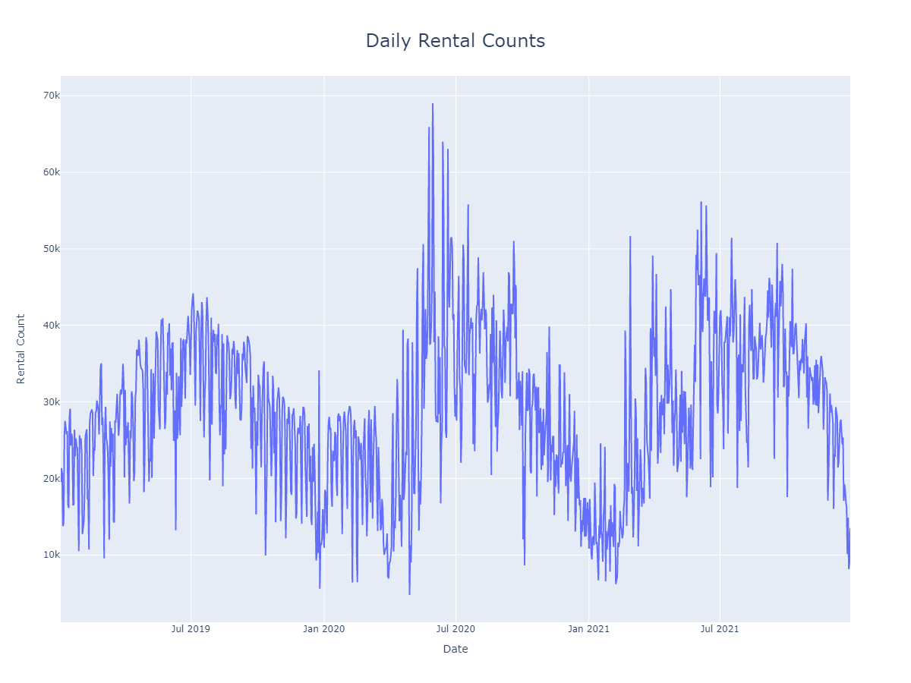
Rentals
Busy During Working hours
Busy During Weekdays
Seasonal Data
Notes:
Seasonality
Daily Peak Hours
Weekdays Peak Hours
Summer Time

Slide 3
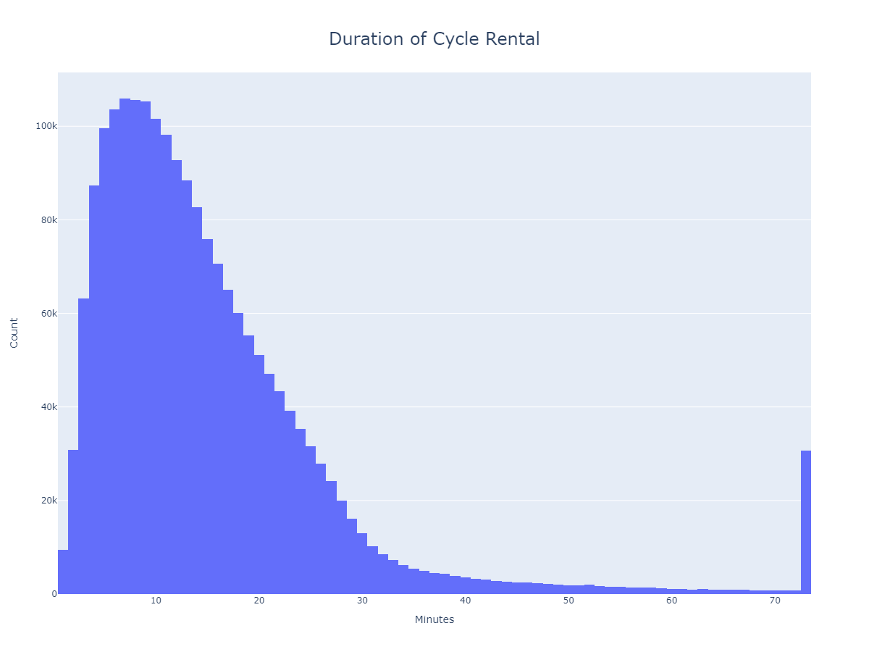
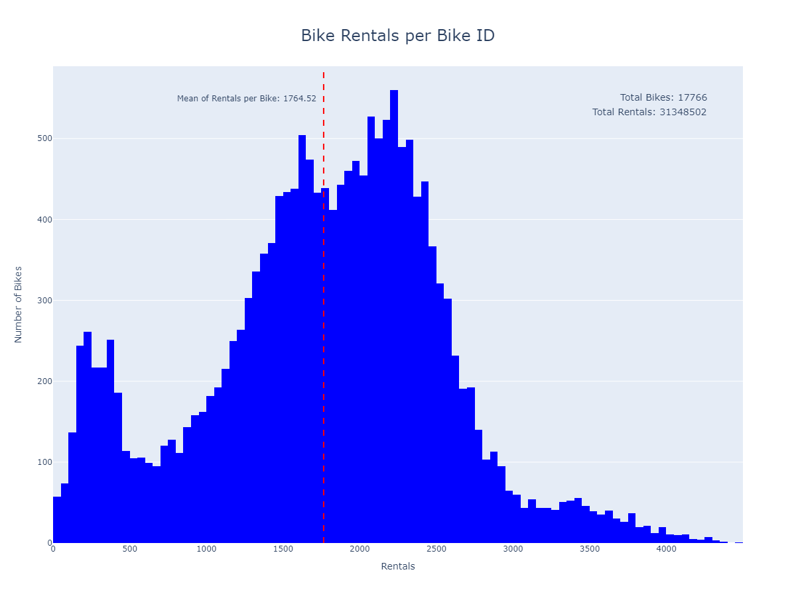
Bikes
Most of the bikes are rented for less than 15 Minutes
Some bikes are rented for multiple days
On a average one bike is rented for only two times a day
Enough Supply for current demand
Notes:
Plan Stock Accordingly
Some Cycles are over used while some are under used
Sufficient Supply for Demand
Proper management can get their cycles

Slide 4
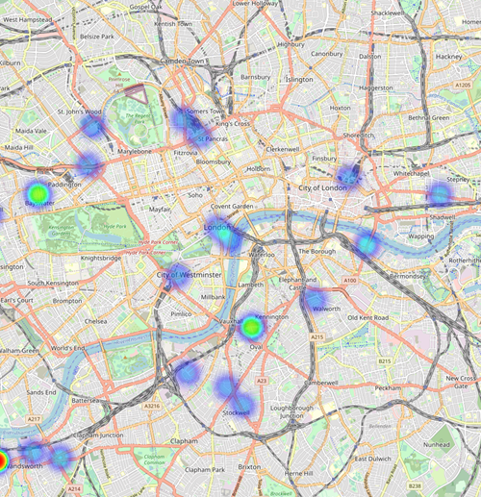
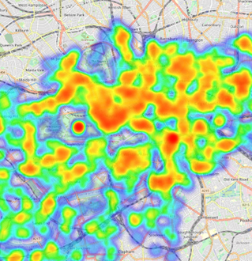
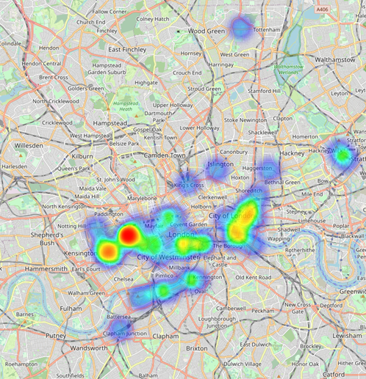
Locations of Stations
Cycle Stations present all over London
Most widely used stations are located in Central London
Least Used stations are located in outskirts of London
Notes:
Spread all over London
Central London has more busy Stations
Outskirts are less busy

Slide 5
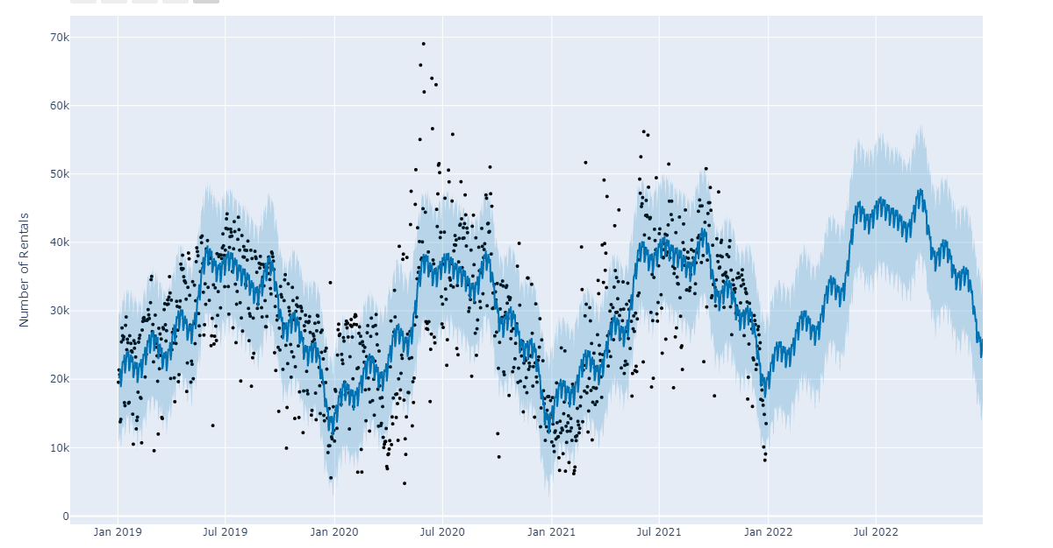
Forecasting
Good Amount of Data to check seasonality
Predictable Results

Slide 6
Recommendations
Expect Similar Patterns for Rentals in future
Can consider 15 minutes pricing to make it more attractive than competitors.
Do partnership with private firms and if possible also with railways.
Target Central London to begin
Can consider Electric bikes to begin with

Slide 7
Thank You.

